Slide 1
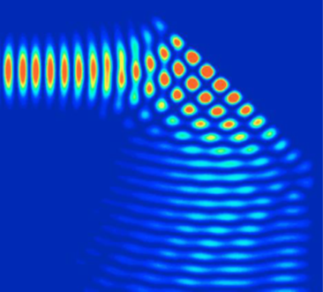

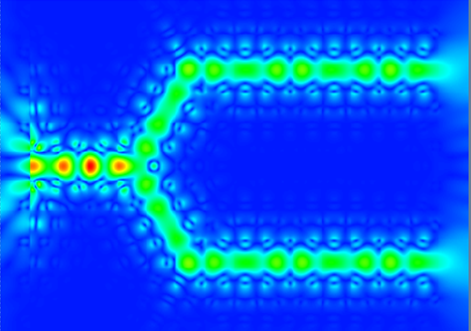

Plasmonic waveguide filters with nanodisk resonators

Slide 2
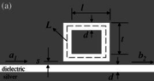
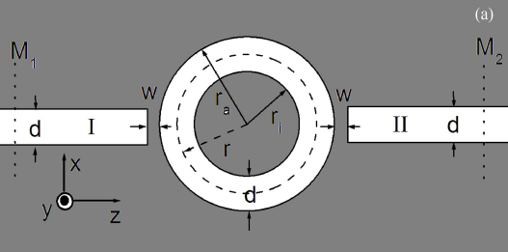


Introduction
Surface plasmon polaritons (SPPs) are waves trapped on the surfaces of metals owing to the interaction between the free electrons in a metal and the electromagnetic field in a dielectric, and attenuating exponentially in the direction perpendicular to the interface. [1]
Compared with insulator-metal-insulator (IMI) plasmonic waveguides, the metal-insulator-metal (MIM) waveguide exhibits a strong confinement of light and has an acceptable propagation length for SPPs. [1]
There are many kinds of plasmonic waveguide filters: tooth-shaped plasmonic waveguide filters [2], channel drop filters with disk resonators [1], rectangular geometry resonators [3] and ring resonators [4].
There exist two types of plasmonic filters in MIM waveguides, i.e., band-pass and band-stop filters. [1]
Channel drop with disk resonator
Tooth-shaped plasmonic filter
Rectangular geometry resonator
Ring resonator
[1] Hua Lu, et al., “Tunable band-pass plasmonic waveguide filters with nanodisk resonators,” Opt. Exp. VOL. 18, NO. 17, 17922-17927 (2010)
[2] X. S. Lin, et al., "Tooth-shaped plasmonic waveguide filters with nanometeric sizes," Opt. Lett. 33, 2874-2876 (2008);
[3] A. Hosseini, et al., “Nanoscale surface Plasmon based resonator using rectangular geometry,” Appl. Phys. Lett. 90(18), 181102 (2007).
[4] T. B. Wang, et al., “The transmission characteristics of surface plasmon polaritons in ring resonator,” Opt. Express 17(26), 24096–24101 (2009).

Slide 3
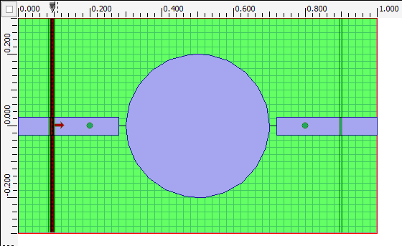
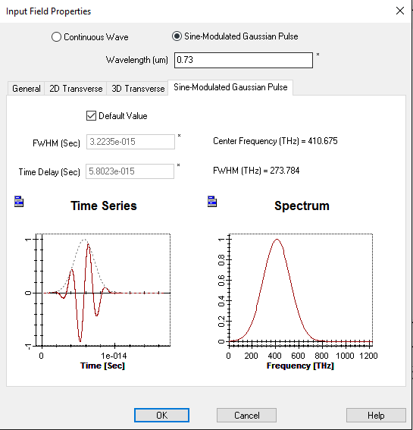
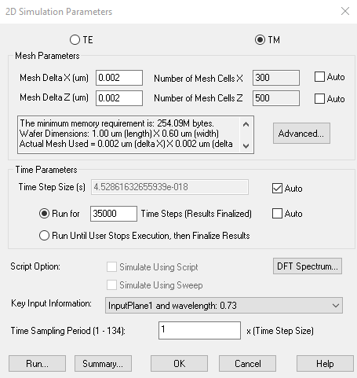
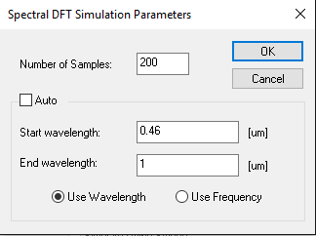
2D FDTD simulation
TM polarized wave should be chosen to excite the SPPs.
The Sine-Modulated Gaussian Pulse is used to obtain results over a range of wavelengths of interest.
The input field transverse is set as a mode field profile (calculated using the mode solver)
The mesh size should be small enough to study the SPPs.
For resonators, the simulation time should be long enough to let the field in the time domain decay to a small value when pulse is used.
The Lorentz – Drude model is used for the dispersion of Silver.
Nanodisk resonator design
Input field settings for SMGP
2D simulation parameters

Slide 4
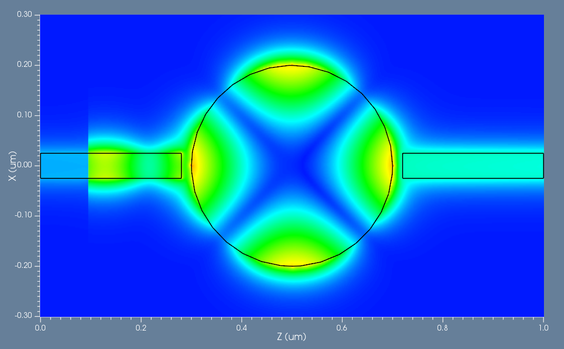
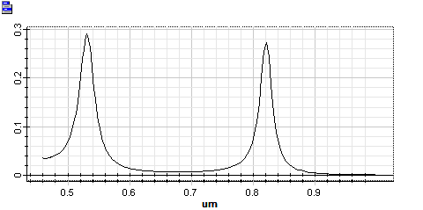
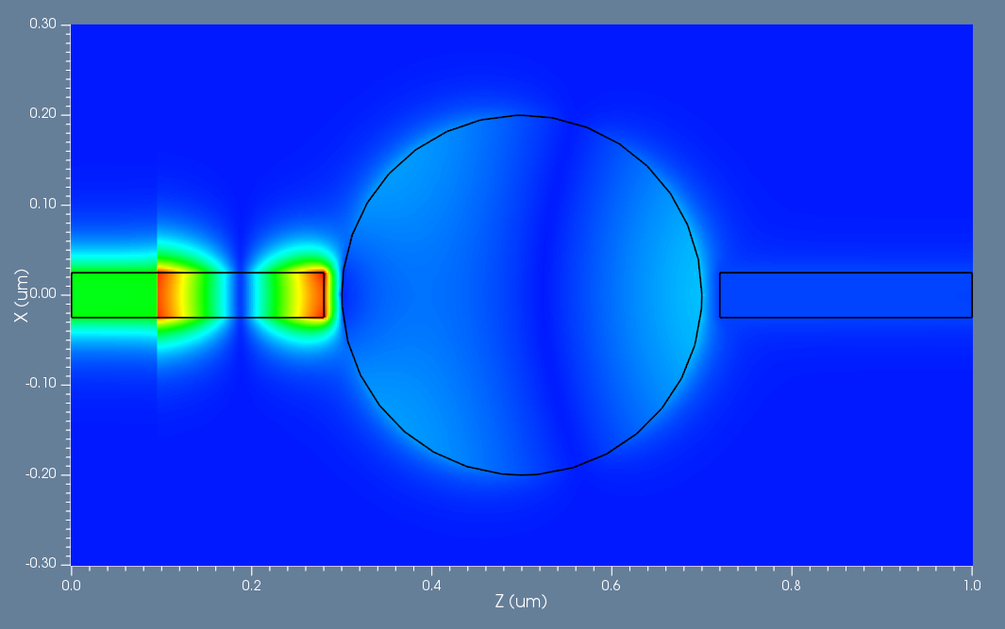
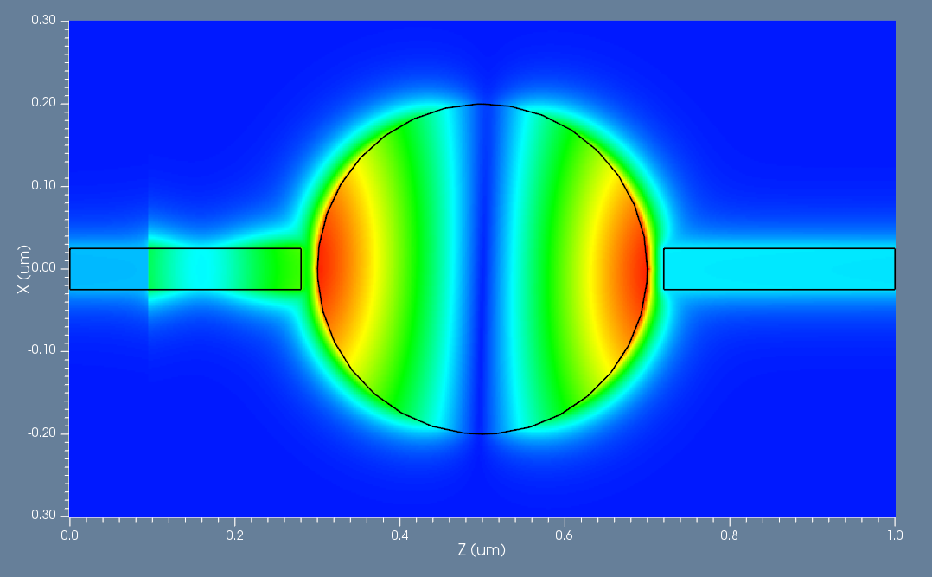
Simulation results
The power spectrum* from the output recorder normalized to the optical source. Two peaks** at wavelength 530 nm and 820 nm are shown.
530 nm
700 nm
Corresponding field profiles of Hz with wavelengths of 530 nm, 700nm, 820 nm, which exhibits the filtering characteristics.
820 nm
*Note: From the power spectrum, obtained directly from OptiFDTD, the filter can be demonstrated. The transmission spectrum can also be calculated using the method shown in Ref 1.
**Note: The slight difference in the peak wavelengths (compared to reference) is due to the different metal model used.

