Slide 1
Theory of Conformal Mapping Method in BPM
Steven R. A. Dods
Optiwave Systems, 7 Capella Ct.
Ottawa, Ontario, K2E 7X1, Canada
Notes:
This presentation is about the Conformal Mapping method in BPM. This method is used when bent waveguides are to be analysed by BPM.

Slide 2
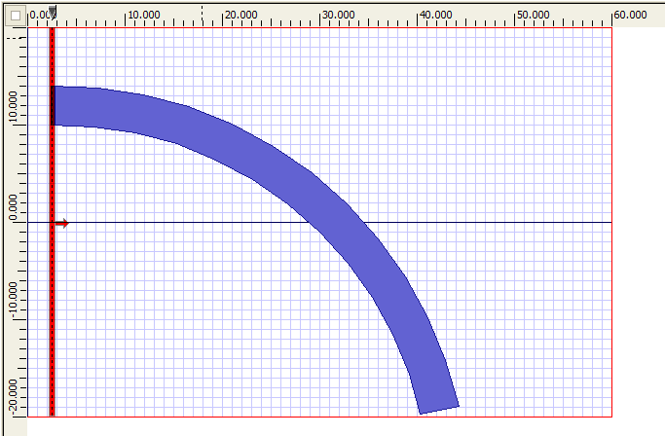
BPM Simulation of bent waveguide
Optical Axis
Simulation not accurate
here: propagation off-axis
Notes:
OptiBPM can simulation propagation on bent waveguides. However, after some distance the propagation changes direction, and will eventually deviate from the optical axis. Since the BP method is paraxial, the simulation becomes less accurate as the propagation progresses.

Slide 3
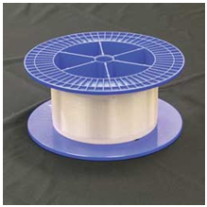
Spool of Optical Fibre
Notes:
This can present a problem if we want to calculate bend loss of say, fibre in a spool. In that case, it could be that significant losses occur only after many revolutions. It could be there is no significant loss after propagation of only a small section of an arc.

Slide 4
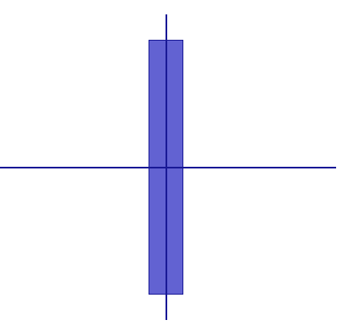
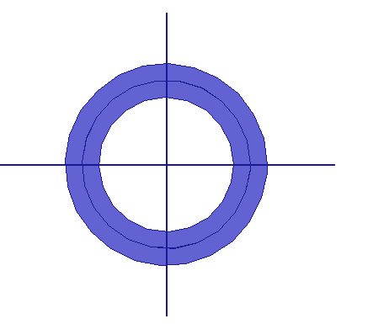
Conformal Mapping
Notes:
It would be possible to use the BPM on circular paths if there was some way of converting the circular problem to a linear one. There is a mathematical trick that can do this, the Conformal Map. Consider a complex plane z and a complex plane w, and suppose the two are connected by an exponential function. By following the definitions, it is clear that a rectangle in the w plane will be mapped to a circular donut shape in the z plane.

Slide 5
Conformal Mapping
Field
satisfies the
Field is
in the w plane.
Helmholtz equation in the z plane
But what is the equation
in the w plane?
Notes:
We know that in the z plane, (which represents the original physical space), the field satisfies the Maxwell equations. In the scalar or semi-vector TE formulation, this is the Helmholtz equation. However, we want to do BPM in the w plane, because it has the paraxial property. The equation in the w plane will certainly be something different. We need to find the equation before it can be solved. Finding the equation in the w plane is fairly straightforward. It is done by replacing the derivatives with the partial derivative chain rule. However, there is a surprise that happens in this case. The surprise is that the transformation does not actually change the form of the DE. It will still be a Helmholtz equation in the w plane. The only difference is that the refractive index distribution is changed according to the radius of curvature, R.

Slide 6
Coordinate transformation
Partial derivative chain rule
similarly
Notes:
The partial derivative chain rule is used to replace the z plane variables x and y with the w plane variables u and v. The Helmholtz equation in the w plane looks like it will become a quadratic form type of expression shown on the right. However, the surprise comes from adding the two terms circled in red. Since w is an analytic function of z, the u and v as functions of x and y will conform to the Cauchy-Riemann equations.

Slide 7
Cauchy-Riemann equations
Must be the same, therefore by
comparing real & imaginary parts
and
i.e.
and
Notes:
Since the exponential is an analytic function, the derivative exists. It doesn’t matter if the derivative is found from a line along the real or imaginary axis. By comparing the real and imaginary parts of those two limits, one gets the Cauchy-Riemann equations.

Slide 8
Coordinate transformation
From the C-R equations:
Therefore
Notes:
Applying the Cauchy-Riemann equations to the Laplace operator in the u-v coordinate system simplifies things considerably. The coefficient of the term with the mixed derivatives is actually zero. Therefore the form of the differential equation is the same in the u-v coordinate system as the original x-y coordinate system. The only change is the multiplication by the Jacobian, J. This J is not a constant. It can be expressed as either a function of x and y, or as a function of u and v.

Slide 9
The new differential equation
The original:
But since
the new differential equation is
So the effect of the bend is just to replace the original refractive index
distribution
with
Notes:
Substituting the expression for the Laplacian in the u-v coordinate system for the original x-y system in the original equation, we get the differential equation for the problem in the u-v coordinate system. This means that a waveguide that follows a circular arc can be transformed into a straight waveguide. The same results for the field will be obtained if the original refractive index distribution is changed by multiplying by a factor of 1/J.

Slide 10
The Jacobian
Az
Aw
Therefore
Notes:
To evaluate the Jacobian, J, it is helpful to consider its definition. The Jacobian measures the amount by which the transformation changes the area of local shapes. For example, a small rectangle in the Z plane is defined by two infinitesimal vectors parallel to x and y axis. The same rectangle is mapped to a parallelogram in the w plane, and the area is changed by a factor. The factor is actually the Jacobian. This Jacobian is a function of x and y. However, the one we need for this application is actually the inverse of this, expressed as a function of u and v instead.

Slide 11
The inverse Jacobian
Aw
Az
Therefore
Notes:
The inverse Jacobian is the same thing, but just going in the oppose direction. It’s definition is found by switching the z plane for the w plane in the previous definition.

Slide 12
The conformal mapping
So
Should be replaced with
Notes:
Now it is simply a matter of using the definition of the conformal mapping to evaluate the partial derivatives and find how the refractive index is changed. It appears the effect of the bend is found by just adding a ramp function to the refractive index distribution.

